Slide 1
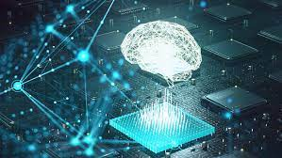



SIGNATURE CLASSIFICATION USING CNN MODEL
PRESENTED BY
UNDER THE SUPERVISION
DR.PRAMOD KUMAR NAIK
ASSOCIATE PROFESSOR
Abdul Hafeez (ENG21CS0004)
Alisha Aric Fernandes (ENG21CS0029)
Bhamini A V (ENG21CS0072)
Dhanvi Bhat (ENG21CS0074)

Slide 2

1 | ABSTRACT
2 | PROBLEM STATEMENT
3 | INTRODUCTION
4 | FUNCTIONAL ,NON-FUNCTIONAL AND SYSTEM REQUIREMENTS
5 | DESIGN
6 | METHODOLODY
7 | COMPARION
8 | RESULTS
9 | LITRACTURE REVIEW 1
10 | CONCLUSION AND REFERENCES
AGENDA

Slide 3
ABSTARCT
Signature classification has traditionally relied on manual comparison of signatures with genuine samples, a process prone to human error and time-consuming. This study presents a novel approach to automate the classification process using machine learning techniques and neural networks. A signature dataset is utilized to develop a predictive model, enabling faster and more accurate classification
Transfer learning is applied by leveraging pre-trained convolutional neural networks (CNNs) such as Xception and VGG16. These models were compared to assess their performance in signature classification. Xception emerged as the top-performing architecture, achieving an outstanding accuracy of 97%.
The automation of signature classification through machine learning offers several advantages over manual methods. It reduces the time required for analysis, eliminates human error, and enhances overall accuracy.
03

Slide 4
PROBLEM STATEMENT
PROBLEM:
Manual comparison of signatures with copies of genuine signatures for classification is a time-consuming process prone to human error. This traditional method not only consumes significant resources but also results in inconsistent and inaccurate predictions. It is crucial to develop an automated solution that can efficiently and reliably classify signatures, overcoming the limitations of manual comparison
SOLUTION:
We have developed an effective solution to address the challenges of manual signature classification by creating a machine learning model using neural networks. This model significantly reduces the time required for classification while achieving high accuracy results
Back to Agenda

Slide 5
INTRODUCTION
Machine learning is a groundbreaking approach invented by humans to simplify complex problems by training computers to mimic human brain functioning. Deep learning, a subset of machine learning, is specifically designed to imitate how humans learn and process specific types of information. It incorporates statistical techniques and predictive modeling, making it highly advantageous for data scientists. Deep learning, with its capability to handle vast amounts of data, has emerged as a powerful tool in various domains.
In the field of deep learning, Convolutional Neural Networks (CNNs or ConvNets) have gained significant popularity, especially in Computer Vision applications. These networks are particularly effective in tasks like image classification, object detection, and recognition. Recognizing the potential of CNNs, we developed a CNN model for signature classification.
To enhance the performance of the model, transfer learning was employed. Transfer learning involves leveraging the pre-trained features of existing CNN architectures such as GoogLeNet, Xception, VGG16, ResNet and etc. we have compared the architectures of Xception and VGG16 to access their performance in signature classification.
Back to Agenda

Slide 6
The evaluation of our models involved computing accuracy, confusion matrix, and classification report. The results obtained were outstanding, showcasing the efficacy of the developed model. Among the two CNN architectures, Xception achieved the highest accuracy of 97%, demonstrating its superior performance in accurately classifying signatures.
The use of transfer learning and the comparative analysis of various CNN architectures highlight the robustness and flexibility of the designed model. By harnessing the power of deep learning and leveraging pre-trained networks, we were able to achieve exceptional Accuracy in signature classification.
The findings of this study provide valuable insights into the potential applications of CNNs and deep learning in signature classification tasks. The high accuracy achieved by Xception signifies its effectiveness in accurately differentiating signatures. These results contribute to the advancement of automated signature classification and have significant implications in fields such as document verification, fraud detection, and forensic analysis
Back to Agenda

Slide 7
REQUIREMENTS
FUNCTIONAL | Preprocessing Feature Extraction Classification Amount transaction
NON-FUNCTIONAL | Security Performance Reliability Usability Accuracy
SYSTEM/SOFTWARE | IDE- Google colab Programming Language-Python Libraries-Tensorflow , Keras API

Slide 8
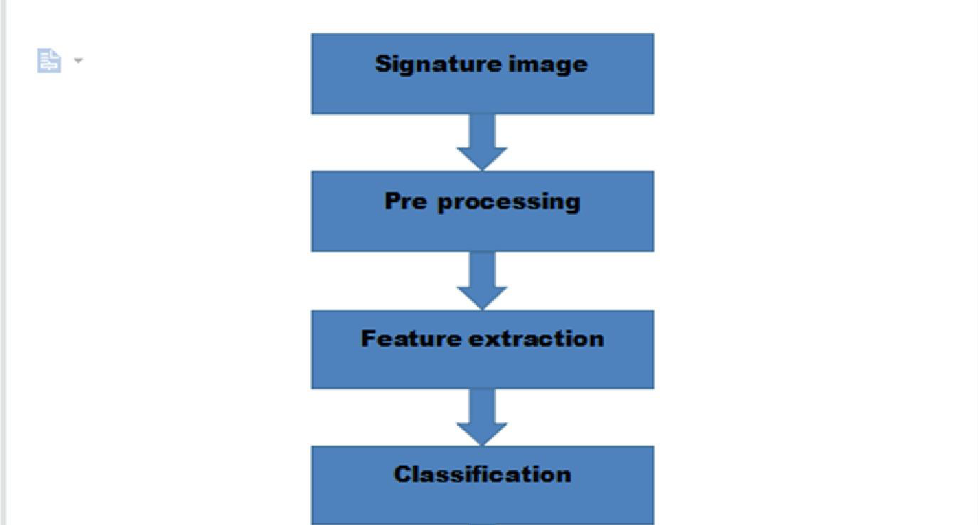
DESIGN
Design workflow diagram

Slide 9
ARCHITECTURE
There are 14 layers which are added sequentially to the model.
Rescaling layer
Random zoom layer
Random rotation layer
Two Conv2D layer
Two MaxPooling2D layer
Batch Normalization layer
Three Dropout layers
Flatten layer
Two Dense layer
Back to Agenda

Slide 10

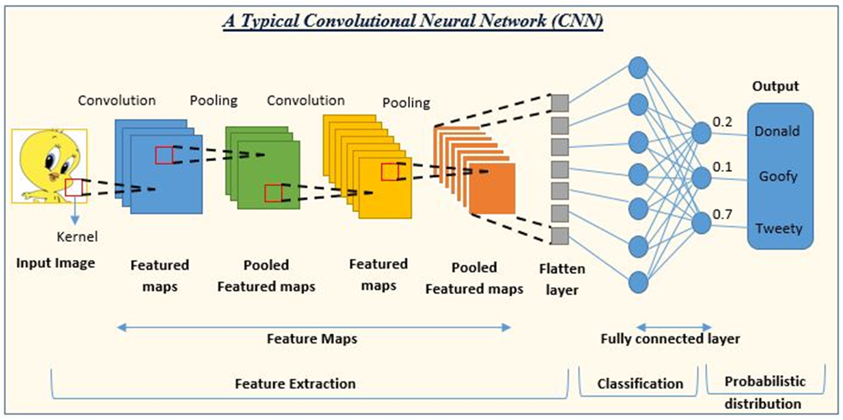
ARCHITECTURE
CNN Architecture

Slide 11
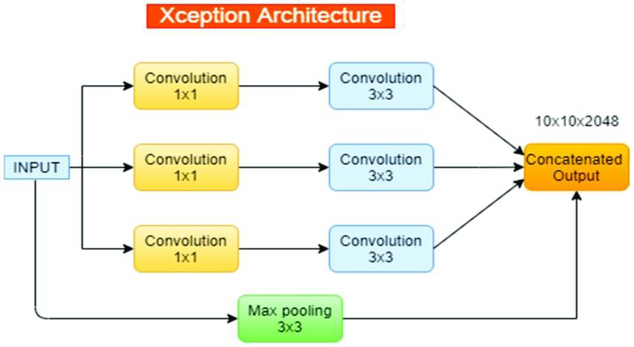
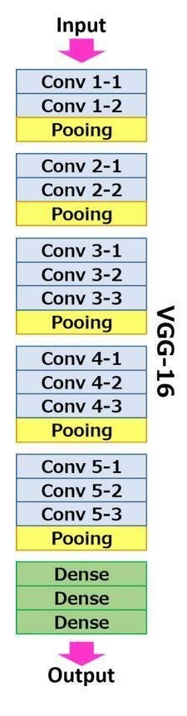
Architecture of Xception
Architecture of VGG16

Slide 12
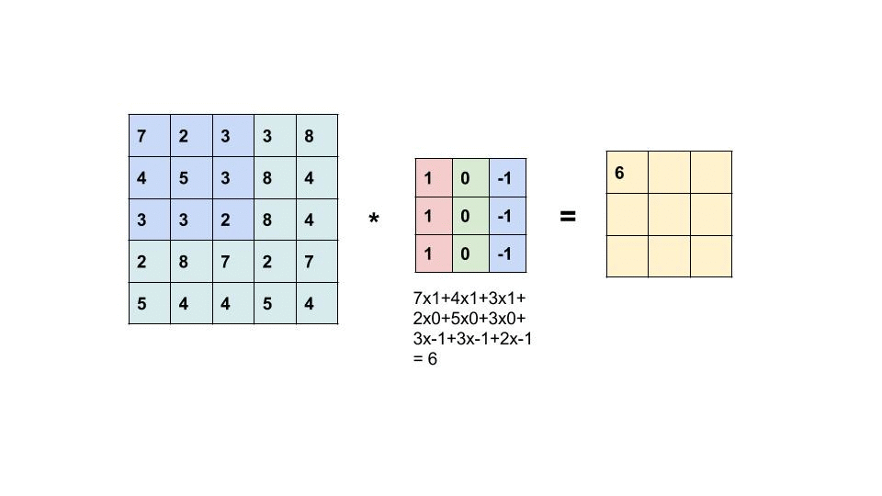
FILTERING OF AN IMAGE

Slide 13
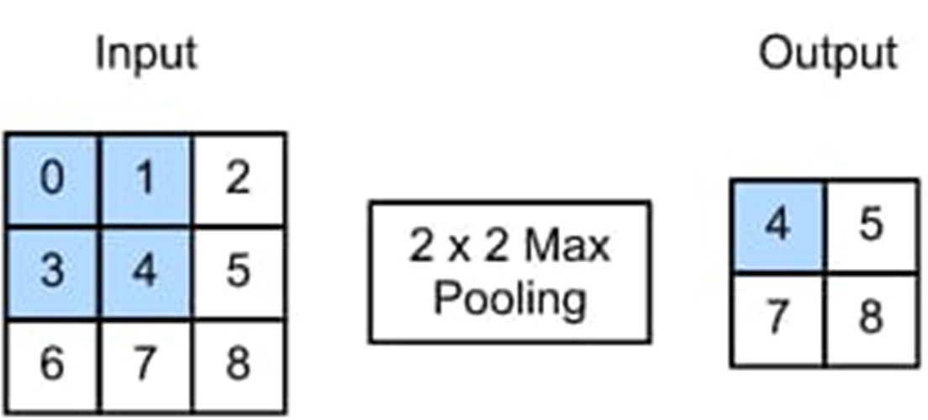
MAX POOLING

Slide 14
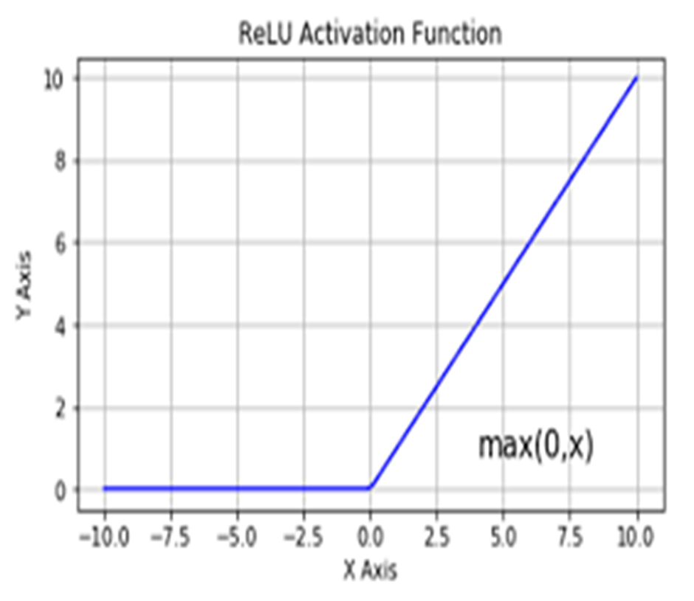
RELU FUNCTION

Slide 15
BRIEF
Rescaling: This layer rescales the input image pixel values to a specified range (usually between 0 and 1) to help improve training.
RandomZoom: This layer randomly zooms into the input image to add more variability to the training data.
RandomRotation: This layer randomly rotates the input image to add more variability to the training data.
Conv2D: This layer applies a 2D convolution operation on the input image to extract features. The layer has 16 filters (or channels) and a kernel size of (3,3).
MaxPooling2D: This layer performs max pooling operation on the output of the previous layer to downsample the feature maps and reduce the dimensionality. The layer uses a pool size of (2,2).

Slide 16
BatchNormalization: This layer normalizes the output of the previous layer to help improve training and reduce overfitting.
Dropout: This layer randomly drops out (disables) a fraction of the neurons to help reduce overfitting.
88Conv2D_1: This layer applies another 2D convolution operation on the output of the previous layer to extract more complex features. The layer has 16 filters and a kernel size of (3,3).
MaxPooling2D_1: This layer performs another max pooling operation on the output of the previous layer to further downsample the feature maps. The layer uses a pool size of (2,2).
Dropout_1: This layer randomly drops out a fraction of the neurons again to help reduce overfitting.
Flatten: This layer flattens the output of the previous layer into a 1D vector to feed into the dense layers.

Slide 17
MaxPooling2D_1: This layer performs another max pooling operation on the output of the previous layer to further downsample the feature maps. The layer uses a pool size of (2,2).
Dropout_1: This layer randomly drops out a fraction of the neurons again to help reduce overfitting.
Flatten: This layer flattens the output of the previous layer into a 1D vector to feed into the dense layers.
Dense: This layer is a fully connected (dense) layer with 256 neurons that performs a linear operation on the input vector followed by a non-linear activation function (usually ReLU).
Dropout_2: This layer randomly drops out a fraction of the neurons to help reduce overfitting.
Dense_1: This layer is the output layer with 4 neurons (assuming this is a multi-class classification task) that performs a linear operation on the input vector followed by a softmax activation function to output probabilities for each class.

Slide 18
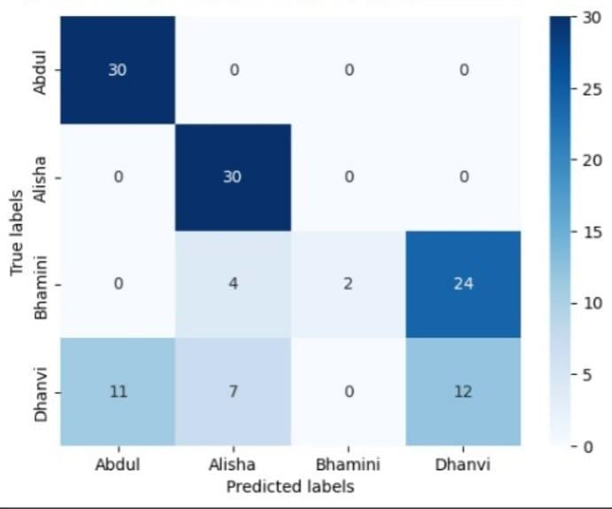
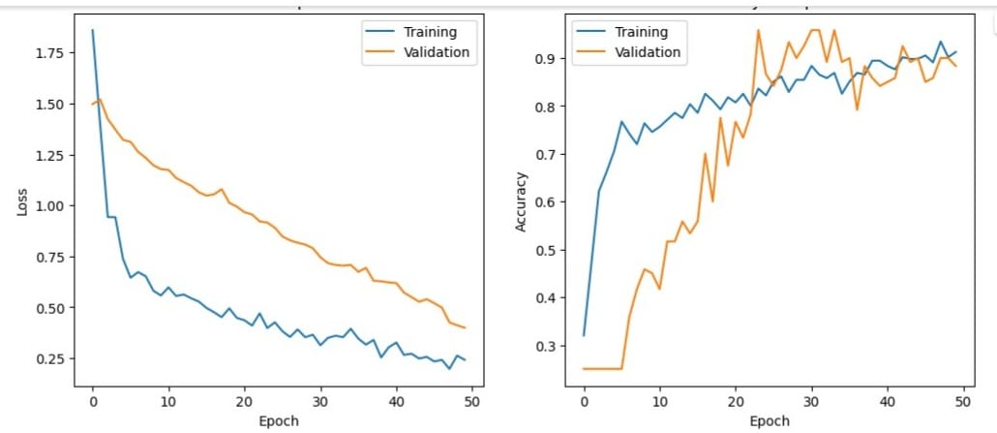
ANALYSIS
Loss and Accuracy graphs of test and validation data
Confusion matrix

Slide 19
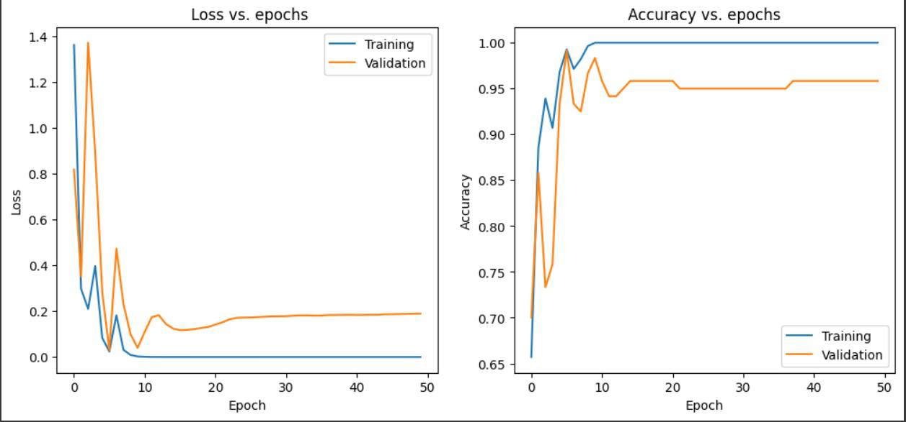
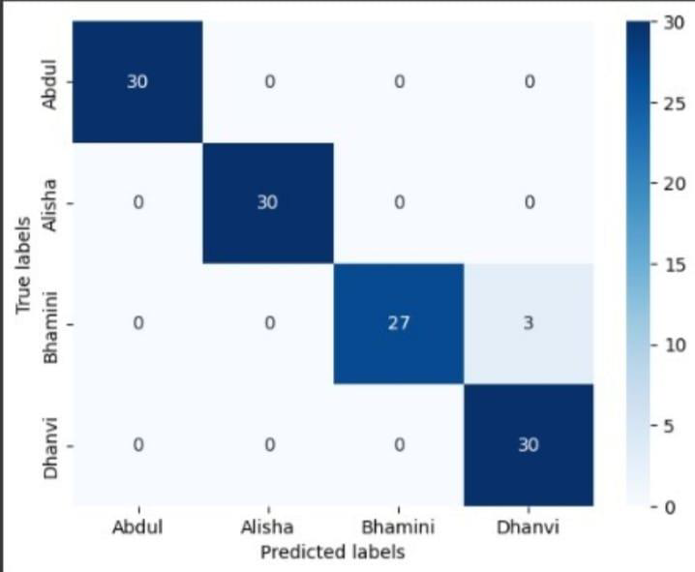
66666666
Loss and Accuracy graphs VGG16
Confusion matrix of VGG16

Slide 20
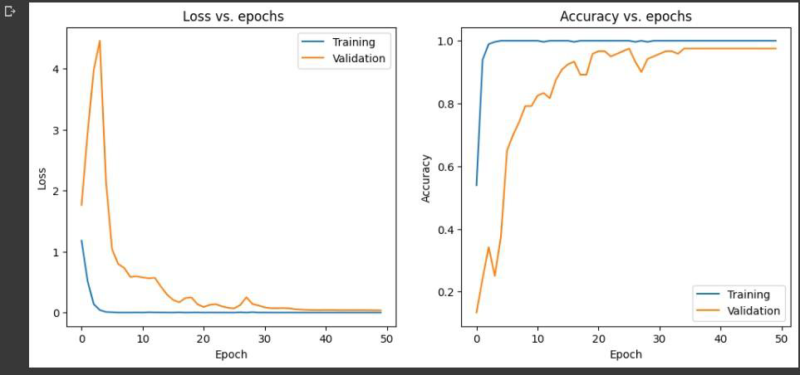
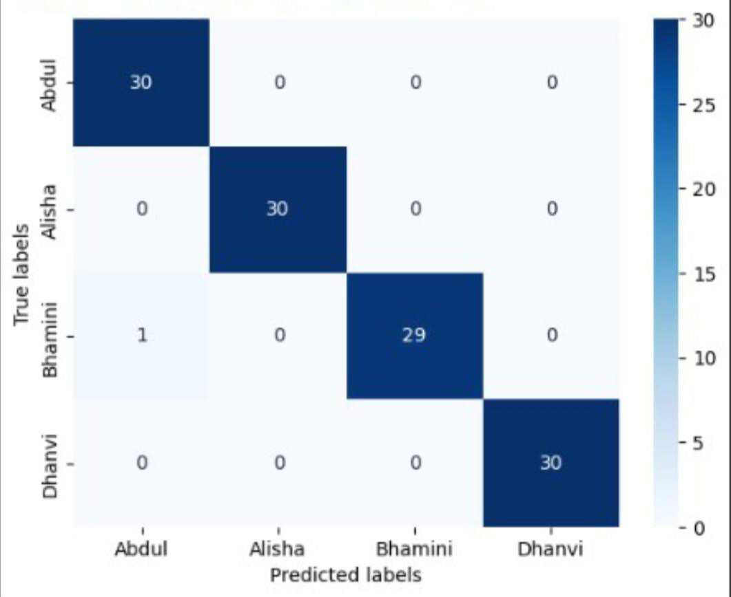
66666666
Loss and Accuracy graphs Xception
Confusion matrix of Xception

Slide 21
CLASSIFICATION REPORT
 | Precision | Recall | F1-Score | Support
Abdul | 0.73 | 1.00 | 0.85 | 30
Alisha | 0.73 | 1.00 | 0.85 | 30
Bhamini | 1.00 | 0.07 | 0.12 | 30
Dhanvi | 0.33 | 0.40 | 0.36 | 30
Accuracy |  |  | 0.62 | 120
Macro avg | 0.70 | 0.62 | 0.54 | 120
Weighted avg | 0.70 | 0.62 | 0.54 | 120

Slide 22
 | Precision | Recall | F1-Score | Support
Abdul | 1.00 | 1.00 | 1.00 | 30
Alisha | 1.00 | 1.00 | 1.00 | 30
Bhamini | 1.00 | 0.90 | 0.95 | 30
Dhanvi | 0.91 | 1.00 | 0.95 | 30
Accuracy |  |  | 0.97 | 120
Macro avg | 0.98 | 0.97 | 0.97 | 120
Weighted avg | 0.98 | 0.97 | 0.97 | 120
Classification report of VGG16

Slide 23
 | Precision | Recall | F1-Score | Support
Abdul | 0.97 | 1.00 | 0.98 | 30
Alisha | 1.00 | 1.00 | 1.00 | 30
Bhamini | 1.00 | 0.97 | 0.98 | 30
Dhanvi | 1.00 | 1.00 | 1.00 | 30
Accuracy |  |  | 0.99 | 120
Macro avg | 0.99 | 0.99 | 0.99 | 120
Weighted avg | 0.99 | 0.99 | 0.99 | 120
Classification report of Xception

Slide 24
METHODOLOGY
Approach : Collect the dataset of signatures for classification purpose. We did this by manually signing on the paper and created 4 folders(class) in Google drive and mounted it using google colab.
Divide the dataset into training and testing set in 70:30 ratio.
Pre-process the dataset and prepare it for classification.
Train a CNN(convulational neural network) model for signature classification.
Evaluate the performance by calculating accuracy.

Slide 25
COMPARISON
 | VGG16 | XCEPTION
Architecture | Deep Convolution Neural Network(CNN) | Deep Convolution Neural Network(CNN)
Depth | 16 layers | 71 layers
Key Feature | Use of small 3x3 filters with a stride of 1 and padding of 1 | Depthwise Separable Convolutions
Parameters | More than 138 million | Approximately 22 million
Performance | Archieved Success in various computer vision tasks | Achieved the state of the art performance in image classification
Size | Relatively Large and computationally expensive | Smaller and more efficient compared to VGG16
Architectural Difference | Emphasizes depth with multiple stacked convolutional layers | Utilizes depth-wise seaparable Convolutions for improved efficiency
Pretrained Models | Pretrained models are widely available and commonly used | Pretrained models are widely available but less commonly used

Slide 26
RESULTS
Basic CNN
VGG16
]XXXxception
62%
97%
99%
This table conveys about the percentages of all the machine learning models used and gives the best model to implement.

Slide 27
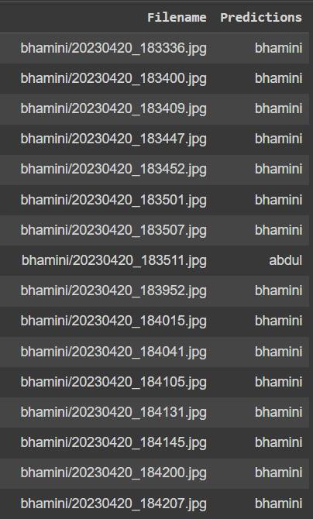
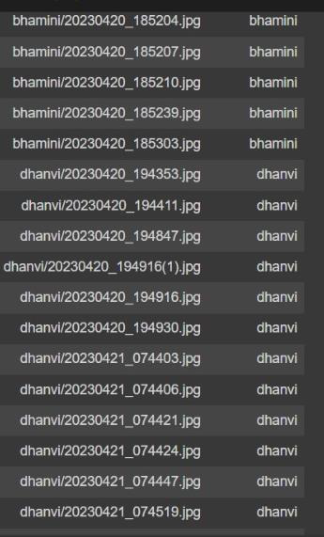
Results of Xception model

Slide 28
LITERATURE SURVEY
Author’s Name/ Paper Title | Conference Name and year | Technology/ Design | Results shared by author | What you infer
DR.R.Palson Kennedy Nitesh Kumar Vinod Kumar “Human Signature Verification using CNN with tesnsorflow | 2022 IJCRT International Journal Of Creative Research Thoughts | CNN | To identify a genuine or a fake signature | Signature has unique feature and can be classified using the neural technology.

Slide 29
CONCLUSION
Signature classification using Convolutional Neural Networks (CNN) is an effective approach that can significantly reduce processing time. By leveraging the power of CNNs, which excel in capturing spatial patterns in images, the classification process becomes more efficient and accurate.
Overall, signature classification using CNNs is a powerful solution that provides both accuracy and efficiency, making it an excellent choice for reducing processing time in signature-related tasks.

Slide 30
REFRENCES
A. Karouni, B. Daya, and S. Bahlak, “Offline signature recognition using neural networks approach,” Procedia Computer Science, vol. 3, pp. 155–161, Jan. 2011, doi: 10.1016/j.procs.2010.12.027.
P. R. Patil and B. Patil, “A Review - Signature Verification System Using Deep Learning: A Challenging Problem,” International Journal of Scientific Research in Science and Technology, pp. 295–298, Apr. 2021, doi: 10.32628/ijsrset2076
T. Raj, S. P. Thangaperumal, and U. Sundarraj, “Signature Verification Using Deep Learning,” T. Raj, S. P. Thangaperumal, and U. Sundarraj, “Signature Verification Using Deep Learning,” ResearchGate, May 2022, [Online].
J. a. P. Lopes, B. Baptista, N. Lavado, and M. Mendes, “Offline Handwritten Signature Verification Using Deep Neural Networks,” Energies, vol. 15, no. 20, p. 7611, Oct. 2022, doi: 10.3390/en15207611.

Slide 31
THANK YOU !!

